Slide 1
Mental Health Workforce Development
Mental Health Mini University
September 6, 2018
Peter F. Buckley, M.D.
Dean, VCU School of Medicine
Executive VP for Medical Affairs, VCUHS

Slide 2
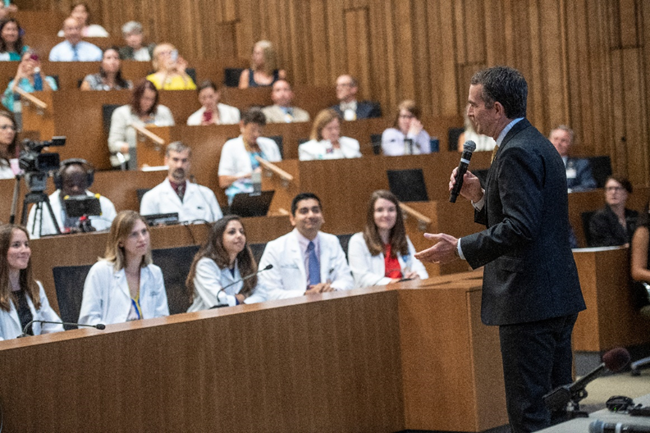
Neighbors… and partners

Slide 3
From 1838…. to…. .… 2018

Slide 4
Presentation Outline
Health and mental health statistics and care needs in Virginia
Physician training pathway and overall physician statistics
Statistics on mental health professionals in Virginia
Future needs, models of care, and mental health care environment/healthcare innovations

Slide 5
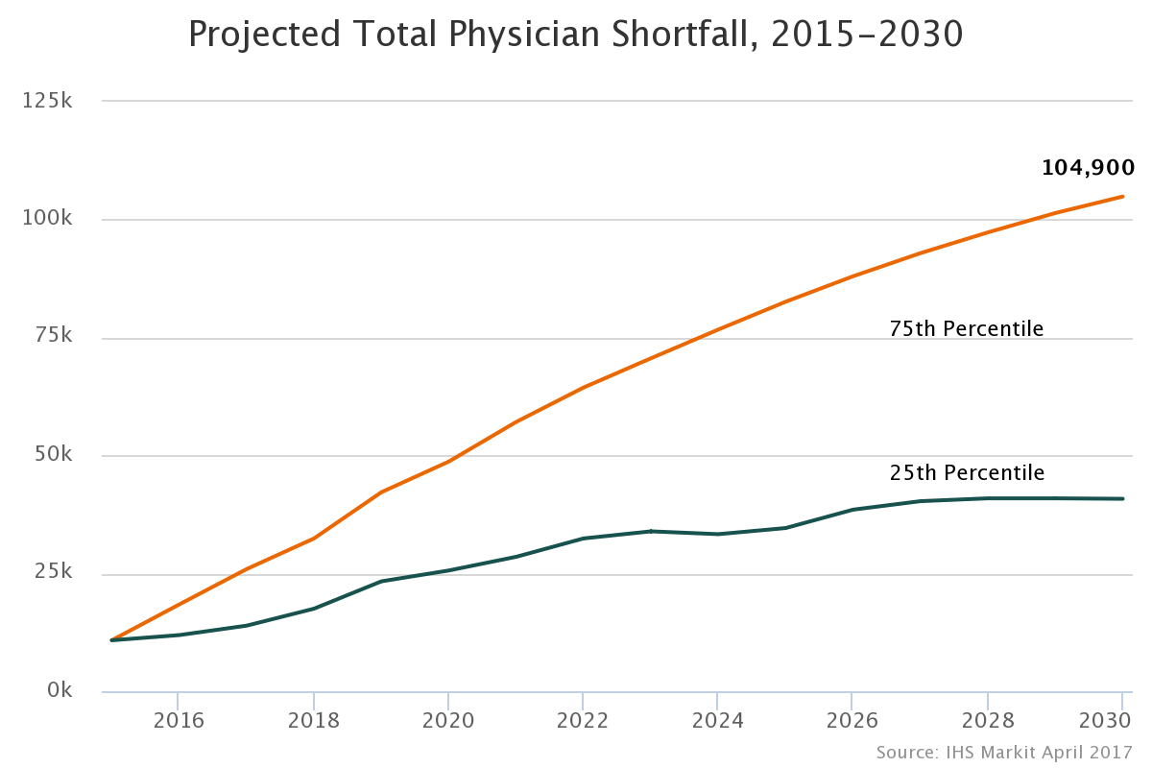
Looming physician shortage in general… and also in mental health
Background & scope of the problem:
Physician shortages expected to exceed 90,000 in next decade
Virginia per capita physician workforce ranks 23rd in U.S.:
VA Per Capita rate – 255.9
U.S. Per Capita rate – 254.5
In contrast to all other health professionals:
Physicians are required to complete 3+ years of graduate medical education (GME), or “residency”

Slide 6
Becoming a doctor is a long haul: Undergraduate Medical Education (UME) and Graduate Medical Education (GME)
College (4 years)
Medical School (4 years)
Residency (3-7 yrs)
Fellowship (optional 1-3 years)
Independent Practice
The path to becoming a physician
Graduate Medical Education (GME)
= minimum of 11 years to become a doctor!

Slide 7
Virginia’s physician and psychologists workforce by the numbers
General:
21,309 active physicians
7,529 primary care physicians
7,558 female physicians
21.3% of physicians are international medical graduates
27.6% of physicians are age 60 years or older
Mental Health:
1,680 psychiatrists
2,536 psychologists
Virginia Department of Health Professions

Slide 8
Virginia healthcare snapshot
Ranked 21st overall in America’s health rankings (2015)
Large disparity in health status by educational level (33rd rank)
3.3 poor mental health days (12th rank)
Overwhelming addiction epidemic
3.6 poor physical health days (19th rank)
9.7% of adult population have diabetes (10% nationally)
28.5% of adult population are obese (29.6% nationally; 20th rank)
19.5% of adult population are smokers (18.1% nationally; 31st rank)
Low per capita public health funding ($65; 28th rank)
Virginia has a storied history in mental health
Virginia Tech massacre
Senator Deeds’ tragedy
Jail deaths

Slide 9
Mental health problems are common
~ 1 in 5 U.S. adults (18.5%) experience mental illness in a given year
~ 1 in 25 experience serious mental illness
~ 1 in 5 youths (aged 13-18; 21.4%) experience a mental disorder at some point
1% of adults have schizophrenia
2.6% with bipolar disorder
6.9% with major depression in the past year
18.1% have anxiety disorder
Over 20 million adults with substance abuse
NAMI.org

Slide 10
Mental health problems are common (cont’d.)
50% co-occurrence of addiction and mental health problems
~ 26% of homeless have a mental disorder
46% have either/and substance abuse and mental illness
~ 20% of prisoners/jail inmate have mental illness
Conservatively, serious mental illness costs $193.2B in lost earnings per year
Suicide is the 10th leading cause of death in the U.S.
2nd leading cause among ages 15-24
~ 18-20 veterans die daily by suicide
NAMI.org

Slide 11
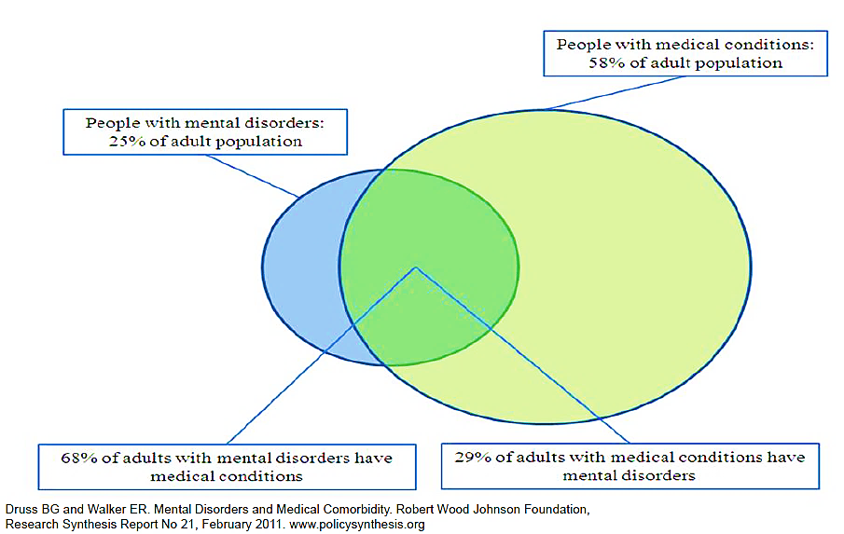
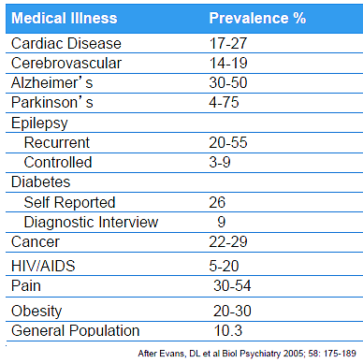
The magnitude of need is compelling, especially when one also considers medical psychiatric co-morbidity
Depression Rates in Medically Ill Patients
Summergrad P, GPPA Summer Meeting, 2013
Virginia’s Medicaid expansion will focus the lens more on mental health and on integration – a great opportunity

Slide 12
Virginia’s mental health system is declining in national rankings – Mental Health America
2011 – ranked 27th
2014 – ranked 38th

Slide 13
Virginia’s mental health system ranked 42nd for access to care in 2017.
“…part of it is the lack of trained professionals working in Virginia, particularly for youth…”
NAMI Virginia

Slide 14
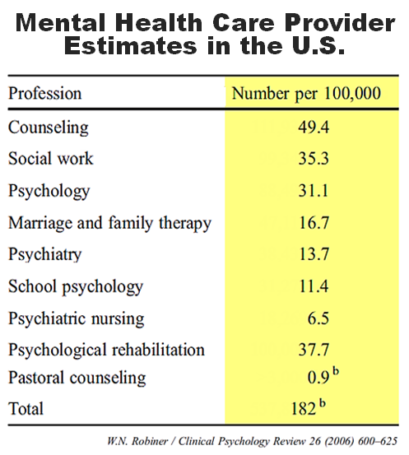
Services provided by health care professionals are critical to communities
Health professions are:
Major and stable part of economy
Growth in jobs outpaces all general economy
In greater demand as population grows/ages
Especially mental health
Diverse professions and most effective when multidisciplinary

Slide 15
The gaps in mental health workforce are broad, deep, and longstanding
Multiple professions make up the behavioral health workforce
Major gaps remain in staffing
Health care changes are likely to exacerbate these shortages
Public systems are typically more stressed and less/less consistent workforce vs. private mental health care
Mental Health Workforce in Virginia
Specialty area | Workforce number
Psychiatrists | 1,680
Psychologists | 2,536
Clinical Social Workers | 5,787
Licensed Professional Counselors | 4,683
Source: Virginia Department of Health Professions

Slide 16
Workforce development aspects for psychiatrists... we need to “skate to where the puck is going to be...”
Disproportionate need for child psychiatrists
Dichotomy between:
Addictions and psychiatry
Psychiatry and consultation liaison
Payment
Salaries vs. other specialties
Private vs. public
Mental health parity
Loan forgiveness programs
Are we training for the right stuff?
Integrated care
Interprofessional care
Best practices and quality metrics in psychiatry
Are we training the right people?
Primary care vs. psychiatry
Partnering with VAMC
Pipeline and advocacy
4% of medical student class
IMG overrepresented
Stigma is a real problem

Slide 17
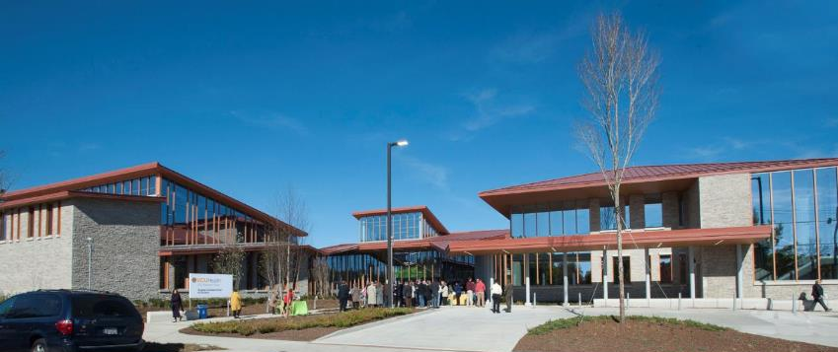
When we normalize our treatment environment, we make it more attractive to trainees (potential psychiatrists, psychologists, counsellors)
Virginia Treatment Center for Children
Notes:
DEBORAH

Slide 18
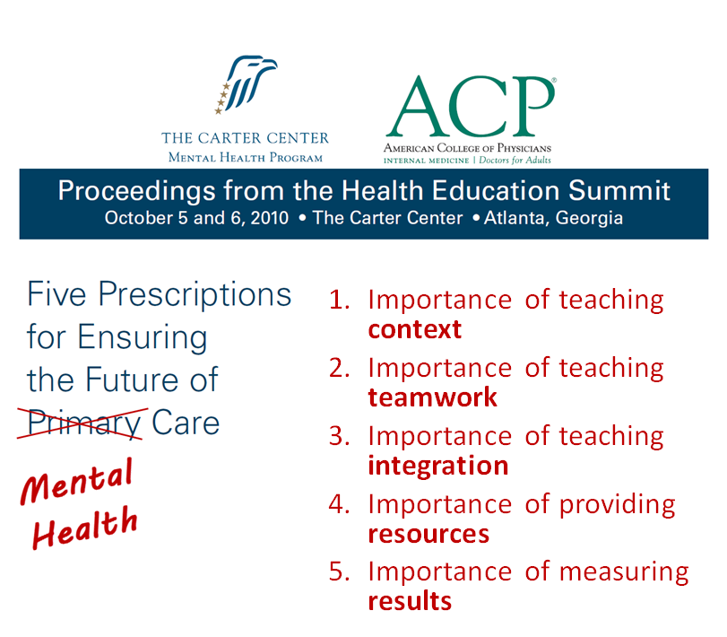
Broad considerations for mental health workforce development
Support and develop the interest and pipeline of students who will choose careers in mental health
Create new programs and novel, tailored coursework focusing on mental health care
Establish programs that prepare mental health APRNs and nurse managers
Create dedicated education pathway for mental health social workers
Peer support specialists
Develop and support specialization of areas of particular need
Forensic/correctional psychology and psychiatry
Child psychiatry and developmental pediatrics
Consultation liaison psychiatry
Better blend with addiction: dual training tracks

Slide 19
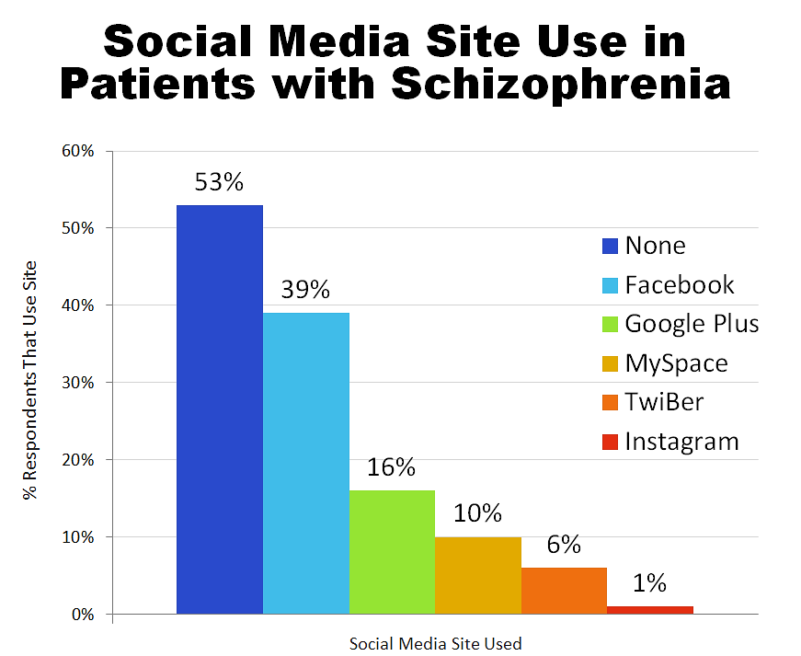
Changes in health care access and delivery could alter workforce needs and therapeutic focus
Social media is increasingly used by people with mental health issues
Use may aggravate conditions (e.g. suicidality, Ogburn and Buckley 2012) or may provide new therapeutic opportunities (e.g. Asperger’s Syndrome)
“Headspace” social media used for primary prevention in Australia
Mobile technology also applicable to mental health
Reminders for care
Relapse prevention
Miller et al 2016

Slide 20
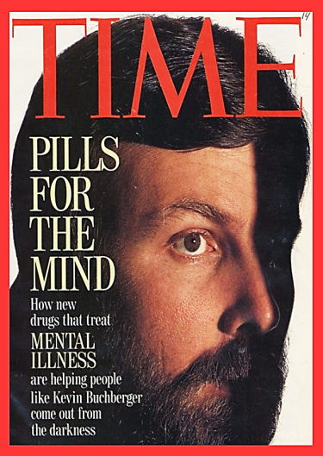
Other blue sky opportunities that could radically alter mental health workforce needs and “deployment”…VCU’s focus also
Social media and mobile technologies
Telemedicine
Especially if it pays!
Peer support services – especially if it pays!
Biomarkers for mental illness
Genetics and pharmacogenetics… always
Drug development… always
Cognitive remediation
... And many others...
Keefe et al, 2012

Slide 21
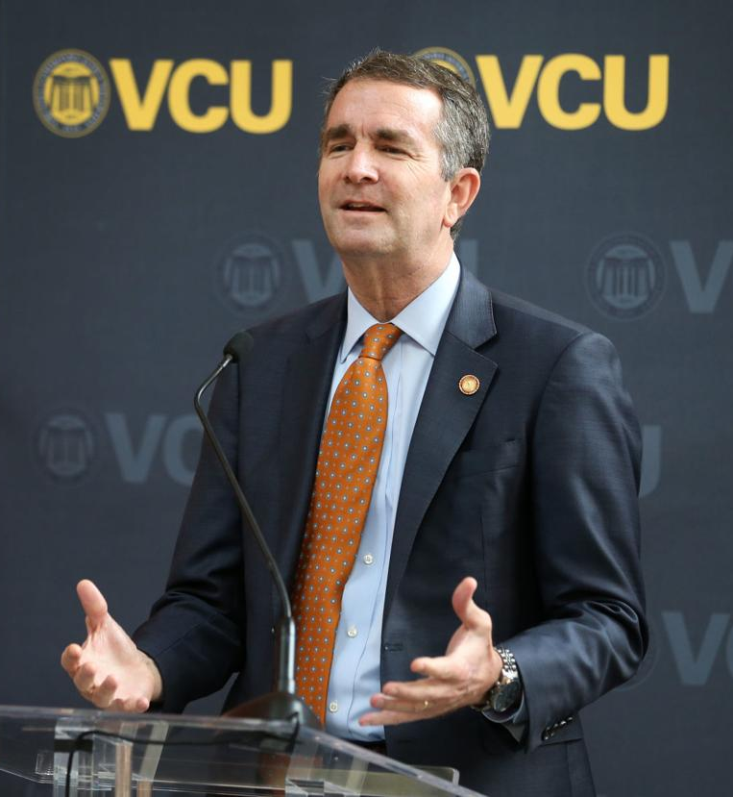
Supporting the important work of Deeds’ mental health commission – we have an opportunity… we have an obligation
“The way ahead starts with access to quality health care and public education for every Virginian, no matter who they are or where they live… it depends on smart interventions in the care of addictions or mental health challenges.”
Governor Ralph Northam
January 13, 2018

Slide 22
Mental Health Workforce – Key take-home points
Mental health problems and addiction problems are common and complex
There are across-the-board workforce shortages
Developing the mental health workforce, service reconfigurations, and innovations (e.g., “mobile mental health”) will collectively alter workforce needs into the future – though the need will still be great
Medicaid expansion will further focus attention on mental health as priority, as well as physical healthcare-mental healthcare integration
We have an opportunity… and an obligation

Slide 23
Mental Health Workforce Development
Mental Health Mini University
September 6, 2018
Peter F. Buckley, M.D.
Dean, VCU School of Medicine
Executive VP for Medical Affairs, VCUHS

