Slide 1
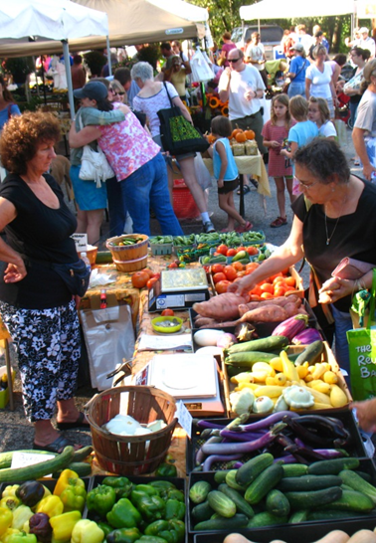
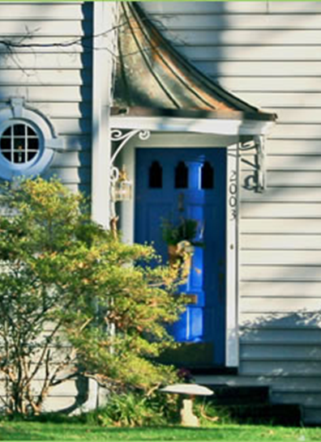
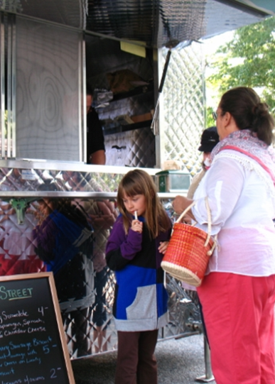
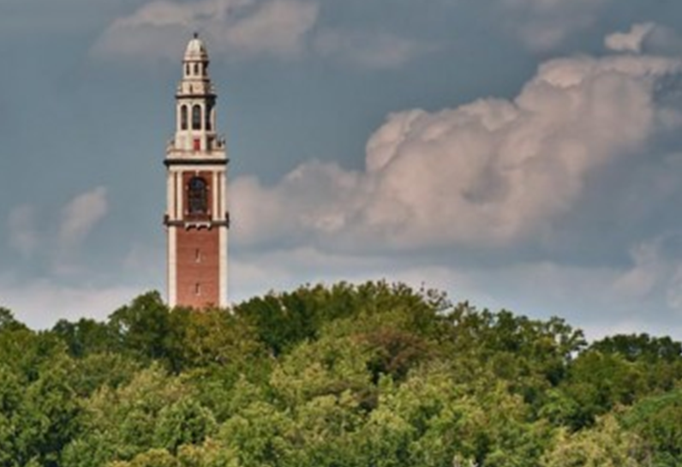
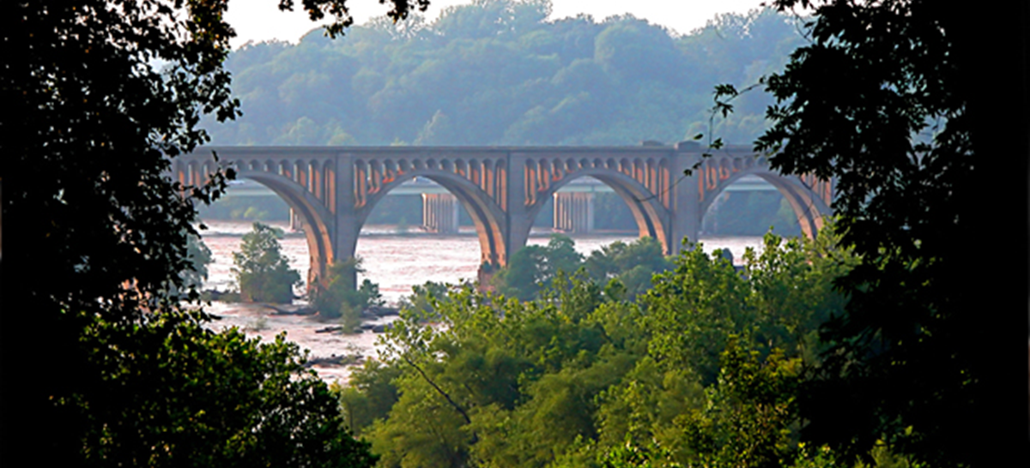
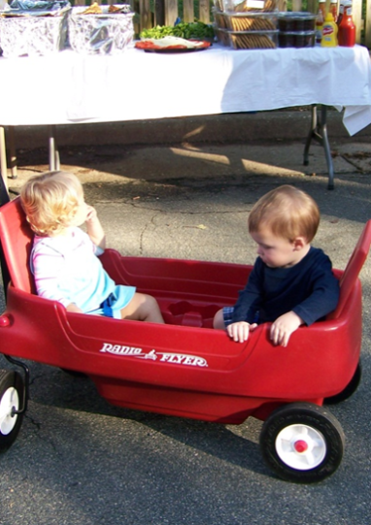
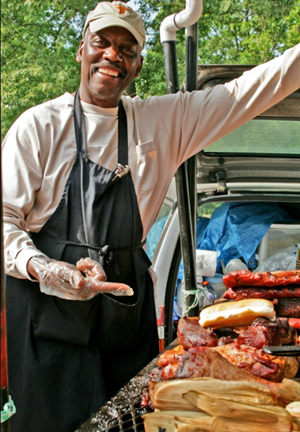
Westover Hills Commercial District
Virginia Commonwealth University – Urban and Regional Planning
Urban Commercial Revitalization Class – Fall 2011

Slide 2
WELCOME

Slide 3
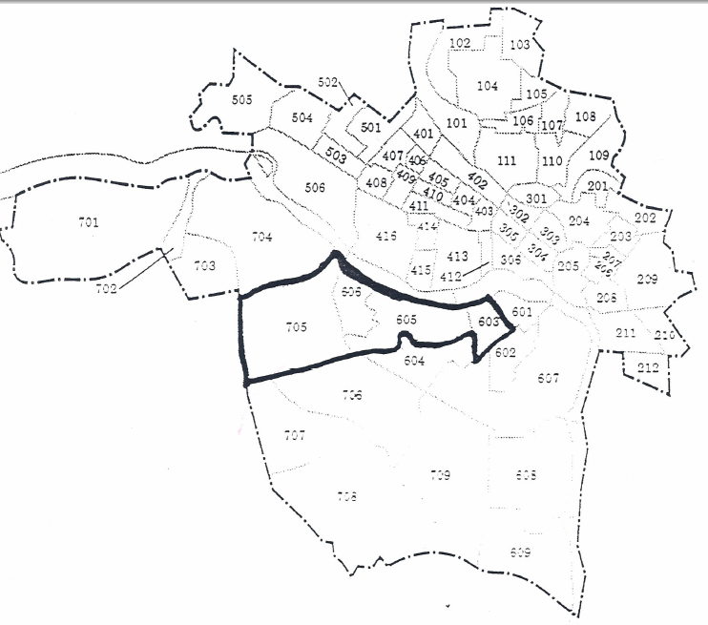
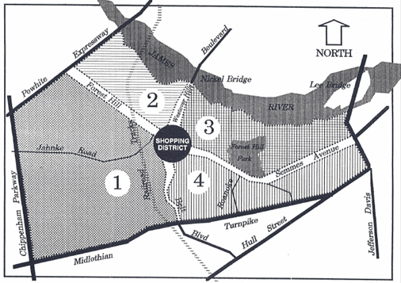
Previous Plans
Urban Commercial Revitalization (1990)
Westover Hills Shopper Profile (1993)
Walks of Westover Master Plan (1995)
Notes:
Urban Commercial Revitalization Plan (1990)
Conducted by the Spring 1990 VCU Urban Commercial Revitalization class
Restaurants and convenience stores identified as having the most growth potential.
Potential expansion of food and neighborhood-based services.
Busy streets and lack of visual appeal present challenges.
Strong connection to surrounding neighborhoods is vital for success.
Organization came back to life
Recommended the active participation of a merchants association in implementation.
Two primary goals of plan: diversify commercial uses and improve the overall appearance.
Westover HillsShopper Prodile
Strong markets for food-related establishments and family-oriented businesses
2 recommendations:
Use results of market study to attract identified businesses
Develop cohesive theme and image for the district
Introduced “Walks at Westover” theme.
Series of recommendations intended to create a more urban, pedestrian-friendly environment that would distinguish the corridor from surrounding suburban style developments.
Better marked crosswalks, traffic calming measures, façade improvements, etc.

Slide 4
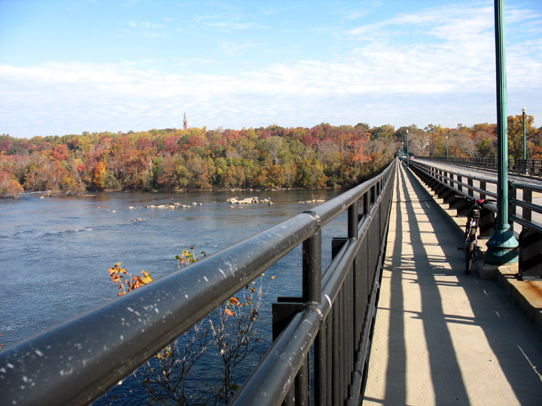
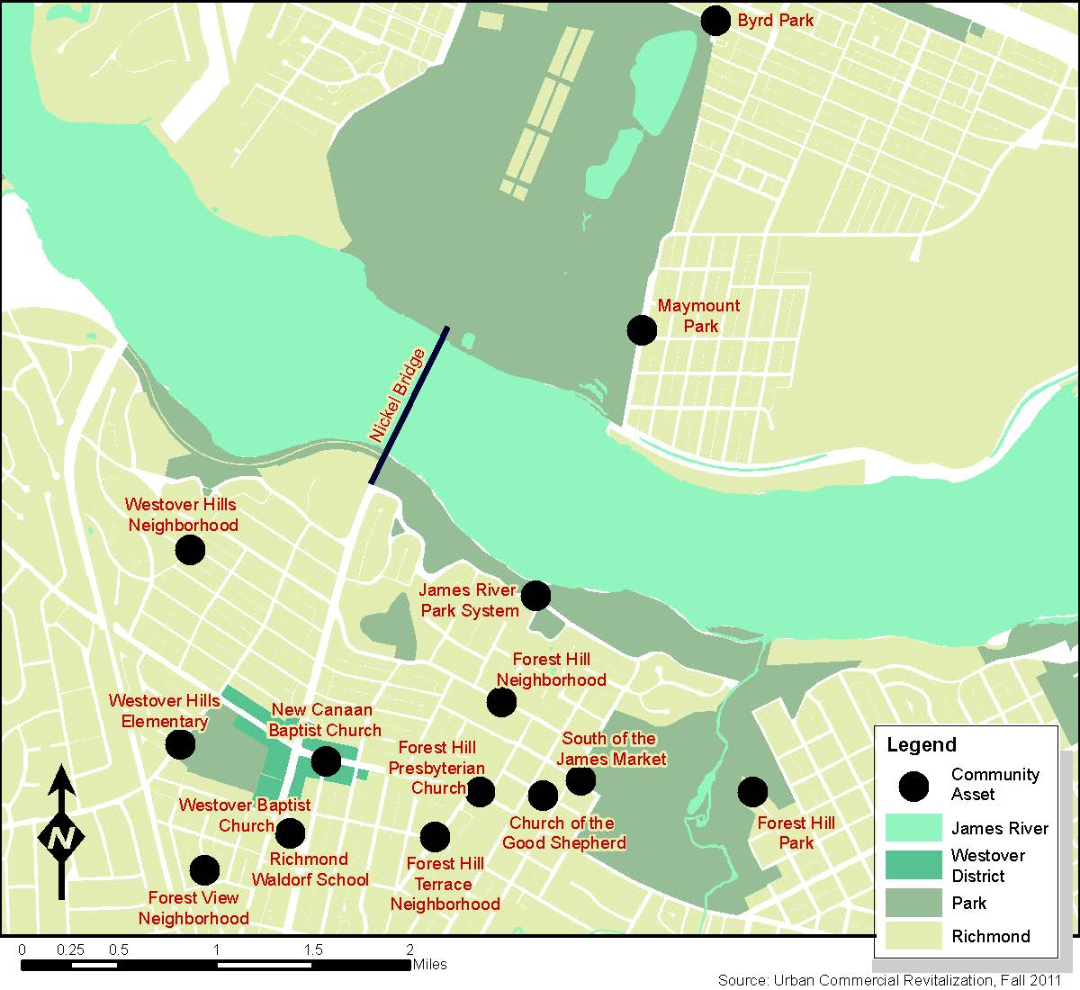
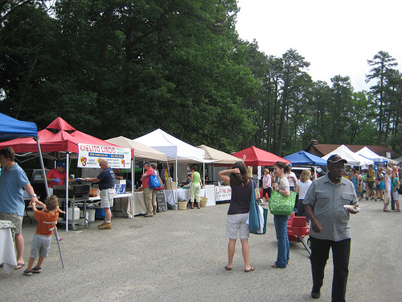
Surrounding Influences
Notes:
Nickel Bridge
Parks
Maymont
Byrd Park
South of the James Farmer’s Market
Schools
Westover Hills Elementary
Waldorf School

Slide 5
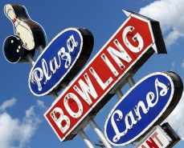
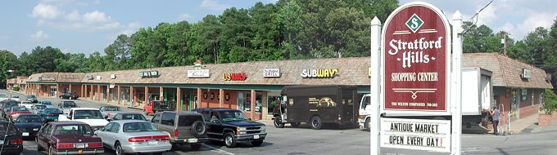
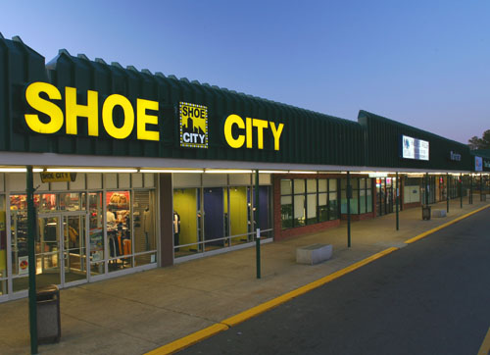
Surrounding Commercial
Parkway Plaza
Stratford Hills
Southside Plaza
Carytown
Characteristics: Central Management, Anchor Stores, Large Shopping Centers
Notes:
Parkway Plaza
Located less than two miles away
Grocery; Sit Down & Fast Food Restaurants; Automotive Services; Apparel; Entertainment; Personal Care/Products
Stratford Hills
Located less than three miles away
Over 80 establishments
Grocery; Sit Down & Fast Food Restaurants; Alcohol/Tobacco; Household Operations; Housekeeping Supplies; Housekeeping Furnishings & Equipment; Apparel; Transportation; Healthcare; Entertainment; Personal Care/Products
Southside Plaza
Located less than two and a half miles away
Over 60 establishments
Food At/Away from Home; Alcohol/Tobacco; Household Operations; Housekeeping Furnishings/Equipment; Apparel; Transportation; Healthcare; Entertainment; Personal Care/Products
All of the other shopping centers are under unitary management except for Carytown which has a large-scale Merchants Association. Each of the neighboring shopping centers is anchored by either a supermarket or a big box chain retailer or in some cases both.

Slide 6
Existing Conditions
Neighborhood District
Active Commercial District
High Traffic
Close to Various Attractions
Vacant Land
More Affordable and Smaller Spaces
Independent and Eclectic Businesses
Unique Design Features

Slide 7
Qualitative Market Research
Parking is not as big an issue to shoppers as it is to merchants.
Customer base is local.
Perceptions differ on issues of crime and safety.
Most see the aesthetic conditions of the corridor to be a detriment to business.
Shopping behaviors were consistent across demographic groups.
Level of engagement from merchants and property owners is low.

Slide 8
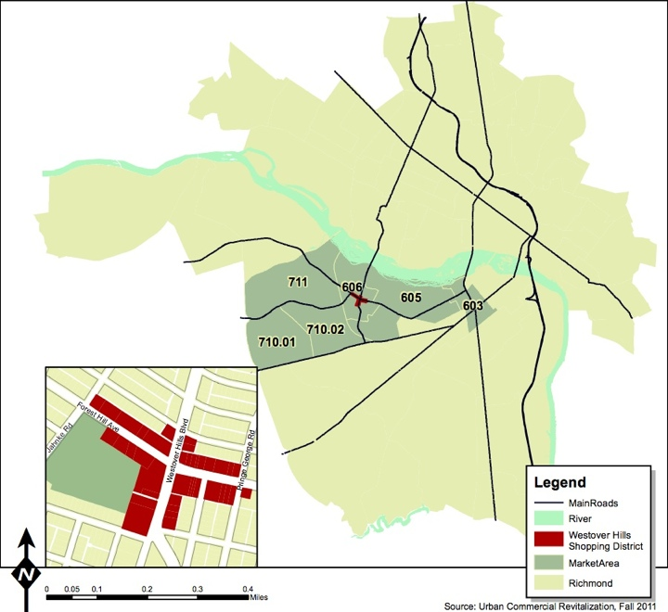
Market Area
Notes:
Here is the convenience market area for Westover Hills determined by using a estimated 5 minute drive time, but constrained within census tracts for analysis purposes. This is the same convenience market area that the Westover Hills Shopper Profile Plan that Sam mentioned.

Slide 9
Quantitative Market Research
Significant Competition Nearby
Mismatch Between What Stakeholders Want and What the Market Can Support
Potential for New Entrepreneurial and Independent Businesses
Notes:
-Can rely on the information from the shopper intercept survey because the demographics align with the Census data.

Slide 10
SWOT Analysis
Strengths
Unique Location
Retail Environment
Invested Stakeholders
Weaknesses
Lack of Cohesive Identity
Curb Appeal
Organization & Collaboration
Opportunities
Vacancies & Underutilized Space
Population Growth
High Traffic Volume
Connectivity to Nearby Assets
Young Families Staying in the Area
Threats
Nearby Commercial Competition
Perceptions of Safety
Absentee Landlords and Property Owners
Business/Leadership
Succession/Continuity

Slide 11
The Four Points
Organization
Establishes consensus and cooperation by building partnerships among various groups that have a stake in the commercial district.
Promotion
Takes many forms, but the goal is to create a positive image that will rekindle, and continue to build community pride.
Business Development Strengthens the districts existing economic assets while diversifying
its economic base.
Design
Getting the district into top physical shape and creating a safe, inviting environment for shoppers, workers, and visitors.
Notes:
We are going to be developing recommendations using a balanced approach to commercial revitalization, known as the Main St approach and uses these four components.

Slide 12
ORGANIZATION

Slide 13
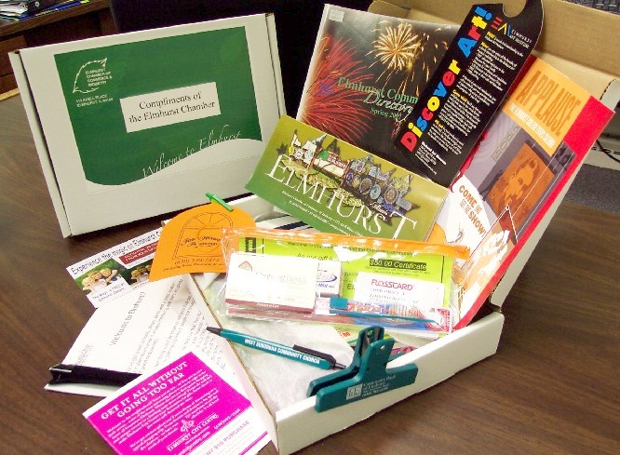
Build Membership of Merchants Association
Leadership Development
Benefits of Membership Packet
Merchant Outreach
Annual Membership Drive

Slide 14
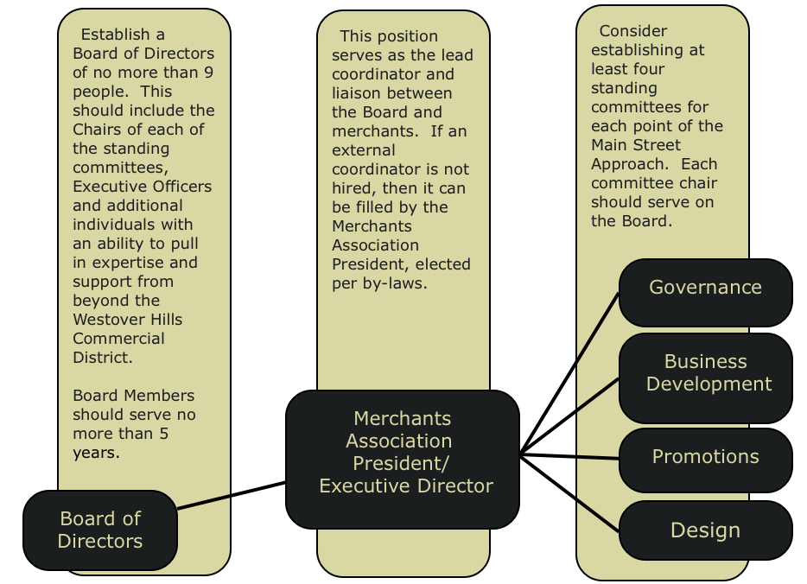
Develop Strategic Plan for Merchants Association

Slide 15


Increase Revenue Streams for the Merchants Association
Hold an Annual Fundraising Event
Create an Annual Fundraising and Budget Plan
Identify and Apply for Appropriate Loans, Grants and Foundational Support

Slide 16

Recruit and Engage Volunteers
Develop a Volunteer Bank of At Least 25 Committed Volunteers
Hold Annual Volunteer Recognition Event

Slide 17
BUSINESS DEVELOPMENT
Notes:
The Main Street Approach states that “By helping existing businesses expand and recruiting new ones to respond to today’s market [Business Development] help[s] to convert unused space into productive property and sharpen the competitiveness of business enterprises.” - From the Main Street Approach®
The Westover Hills Commercial District is home to successful small businesses, surrounding neighborhoods that shop local and a high volume of traffic all at an affordable price. By building on these strengths to retain current businesses and recruit new business based on analysis of the market so that the Westover Hills Commercial District will be well-positioned for years to come. The following vision, goals and objectives seek to promote a thriving business community in the Westover Hills Commercial District.

Slide 18
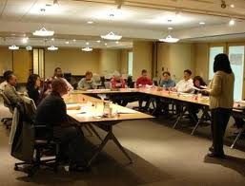
Support Existing Businesses
Business Improvement Seminars
Customer Service
Social Media Marketing
Setting Up An Online Store Front
Money Management For Entrepreneurial Businesses
Topics That Are Of Interest To Merchants Within The District
Notes:
• Small businesses face unique challenges but may not be up to date on best management practices. Because their time and resources can be limited, group consulting, workshops and seminars can connect small merchants with resources that might otherwise be cost prohibitive. The Merchants Association and previously mentioned Business Development Committee, Greater Richmond Chamber of Commerce’s Small Business Development Center, SCORE Richmond, and Business First Richmond
• Business improvement workshops/seminars such as the ones listed will encourage merchants to make viable choices for their businesses. Additionally businesses should complete the free Virginia Small Town and Merchant Program’s Retail Business Check-up and/or Restaurant Check-up annually which can assist with some of the challenges individual businesses face.
Additionally, the Business Development Committee should coordinate with the Richmond Chamber of Commerce to schedule training sessions within the Westover Hills Commercial District specifically designed for Westover Hills merchants.
http://www.google.com/imgres?q=small+business+succession+planning&start=659&num=10&hl=en&gbv=2&biw=1366&bih=659&tbm=isch&tbnid=uuNTlQimjFZshM:&imgrefurl=http://www.sfdhr.org/index.aspx%3Fpage%3D293&docid=fcQLQBkprVXD-M&imgurl=http://www.sfdhr.org/Modules/ShowImage.aspx%253Fimageid%253D800&w=439&h=336&ei=6EHcTqP1B-bI0AH-v9jBDQ&zoom=1&chk=sbg&iact=hc&vpx=1065&vpy=260&dur=920&hovh=196&hovw=257&tx=193&ty=85&sig=107578744456362868518&sqi=2&page=33&tbnh=133&tbnw=179&ndsp=19&ved=1t:429,r:5,s:659

Slide 19
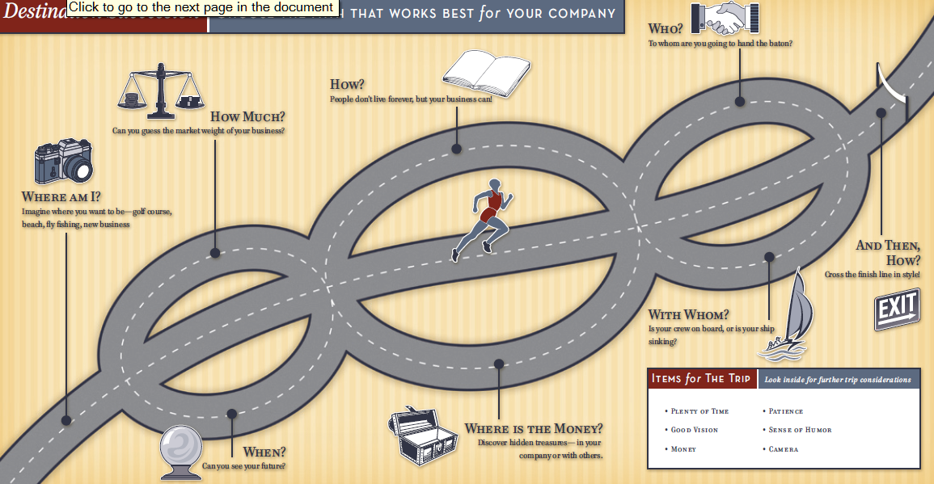
Support Existing Businesses
Succession Planning
According to recent studies by the Small Business Administration (SBA), family businesses are the most dominant form of business in the United States and represent nearly 90% of the total businesses in the US (Davis, P. S. and Harveston, P. D. (1998). The Influence of Family on the Family Business Succession Process: A Multi-Generational Perspective. Family Business Review. 22).
The SBA also reports that less than one third of family businesses survive the transition from first- to second-generation ownership.
Notes:
The district is comprised of mature small businesses with many owners nearing retirement or the end of the business cycle in the next ten to fifteen years Succession planning for small businesses in Westover Hills is vital to prevent a significant vacancy rate in the district.
• Business succession planning is the process of preparing to hand over control of the business to others in a way that is the least disruptive to the business’s operations and value. The first step for succession planning includes identifying merchants nearing retirement and/or businesses looking to sell their businesses or transfer the business to a family member.
• The Business Development Committee should hold workshops/ lectures on succession planning as part of the brown bag lunch series or a special topic seminar hosted by a consultant. Businesses should be linked to organizations that can assist with transitioning their businesses to family members or potential buyers, such as the Greater Richmond Chamber of Commerce, SCORE and the Richmond Retail Merchant’s Association. Free pamphlets on succession planning should be provided to support this outreach effort. Efforts to identify merchants in transition should be a continual priority.

Slide 20
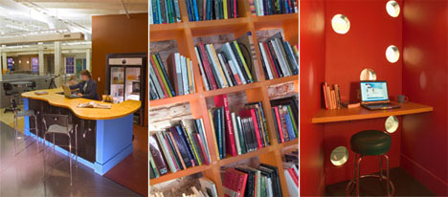
Support Existing Businesses
Resource Center at Library
The International Council of Shopping Center’s Dollars & Cents of Shopping Centers®
The SCORE® 2008
The Small Business Source Book
Small Business Administration Industry Guides
Small Business Tax Information from the IRS
Bureau of Labor Statistics Consumer Expenditure Survey
Small business publications, Main Street tools, and other resources should be compiled and kept at the Westover Hills Library.
Resource Center at C3, 2006
Notes:
By working together, the Business Development Committee, Westover Hills Public Library and Richmond Public Library System can organize and encourage the use of trade journals and publications. Business-specific information and best management practices could greatly improve how local merchants operate their businesses. These resources may be cost prohibitive to individual merchants, but compiled in one central location at the Westover Hills Library they can be made available to all businesses.
• Specific resources such as The International Council of Shopping Center’s Dollars & Cents of Shopping Centers® /The SCORE® 2008, The Small Business Source Book, Small Business Administration Industry Guides, small Business Tax Information from the IRS, Bureau of Labor Statistics Consumer Expenditure Survey, Small business publications, Main Street tools, and other resources should be compiled and kept at the Westover Hills Library. See the Implementation Handbook for a more detailed list of potential resources.
• The Westover Hills Branch Library can request to be the repository for all small business trade publications, reports and journals from the Richmond Public Library System. In addition, the Westover Hills library can request the purchase of any resources not currently available within the Richmond Public Library system that have been identified by the Business Development Committee through a poll of local merchants. The Westover Hills Branch Library can designate space in the library and an email should be sent out to all local merchants informing them of the resources that are available.

Slide 21
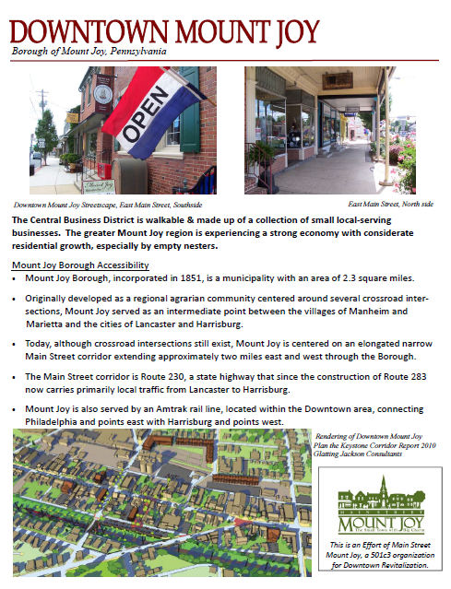
Attract New Businesses
Business Recruitment Packet
Location
Current Businesses
Market Potential
Unmet Demand
Merchants Association Information
Calendar of Events
Relevant Press Information
Notes:
A packet of resources that lets potential businesses and entrepreneurs know that Westover Hills is a valuable commercial district with the potential for independently owned businesses to thrive and establish themselves as a fixture in the business community with a loyal following among fellow merchants and customers.

Slide 22
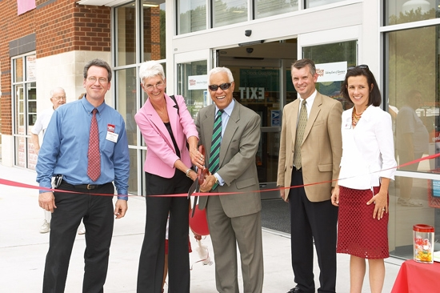
Attract New Businesses
Targeted Business Recruitment
High Level of Unmet Demand:
Music Products
Personal Services
Household Products
Tobacco Products and Smoking Supplies
Entertainment
Notes:
Business Development Committee will work with the Westover Hills Commercial District to attract the types of businesses listed Seeking out expanding businesses or businesses relocating from outside the region would help the Westover Hills Commercial district to position itself as a place for entrepreneurs and small business owners to thrive.
Attend networking events and workshops hosted by the Greater Richmond Chamber of Commerce, The Richmond Retail Merchants Association, Virginia Economic Development Partnership, Greater Richmond Partnership and other professional organizations. Bring copies of Business Recruitment packet, once created, and sell Westover Hills Commercial District as the place for all relevant attendees to do business.
Compile a list of potential new businesses and follow-up with them to build professional relationships and share the benefits of the District by inviting them to relevant events.

Slide 23
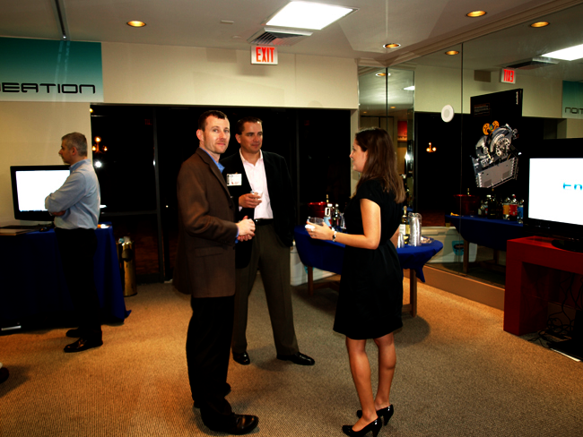
Attract New Businesses
Business Open House Event
Notes:
Business Development Committee should engage business owners and entrepreneurs to see the benefits of the district first-hand and feel camaraderie with fellow businesses, they are more likely to consider locating in Westover Hills. Establishing a supportive, proactive, business-friendly environment will help with recruitment and networking for years to come.
A semi-structured networking event that brings together potential businesses, entrepreneurs and existing merchants to discuss the benefits of being located in the Westover Hills Commercial District.
Recruit a local merchant to host the open house event, preferably a merchant next to a currently vacant space or a property owner/realtor with a vacancy. Then send out invitations to business owners and entrepreneurs met through previous networking events, businesses who fit targeted list outlined in Part I above, and the Greater Richmond Chamber of Commerce and the Richmond Retail Merchants Association. Publicize event on Merchants website as well. Event should last about 2 hours and light food should be provided from a local restaurant. Collect business cards at the door and follow-up with attendees within 2 weeks of event.

Slide 24
PROMOTION

Slide 25
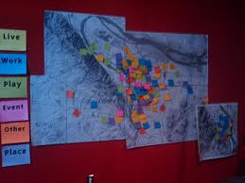
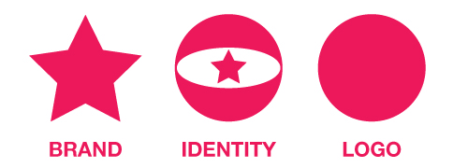
Use Marketing and Promotional Strategies to Identify Westover Hills as a Shopping Destination
Develop an Asset Map
Develop an Identity and Brand
Create a Cohesive Design for Promotional Materials

Slide 26



Use Marketing and Promotional Strategies to Identify Westover Hills as a Shopping Destination
Promote Westover Hills as a Shopping Destination
Share Positive News Stories
Create and Maintain A Website

Slide 27

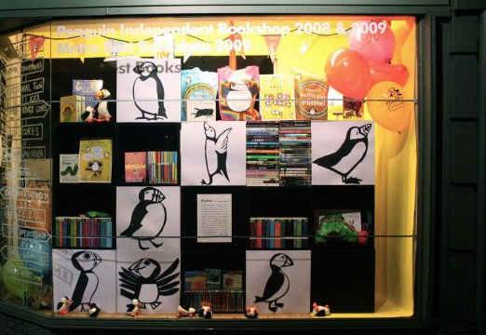
Develop Retail Marketing and Promotional Strategies
Expand Social Media Advertising
Design Attractive Window Displays
Cross Promotional Advertising

Slide 28


Organize and Promote Special Events in Westover Hills
Organize Special Events
Create and Maintain a Calendar of Events

Slide 29
DESIGN

Slide 30
Establish the Westover Hills Commercial District as a Distinct Place in the City of Richmond
Install Banners that Visually Identify the Westover Hills Commercial District
Install Way-finding Signs to Connect the Westover Hills Commercial District to Nearby Attractions
Place a Design Feature at Each Gateway

Slide 31
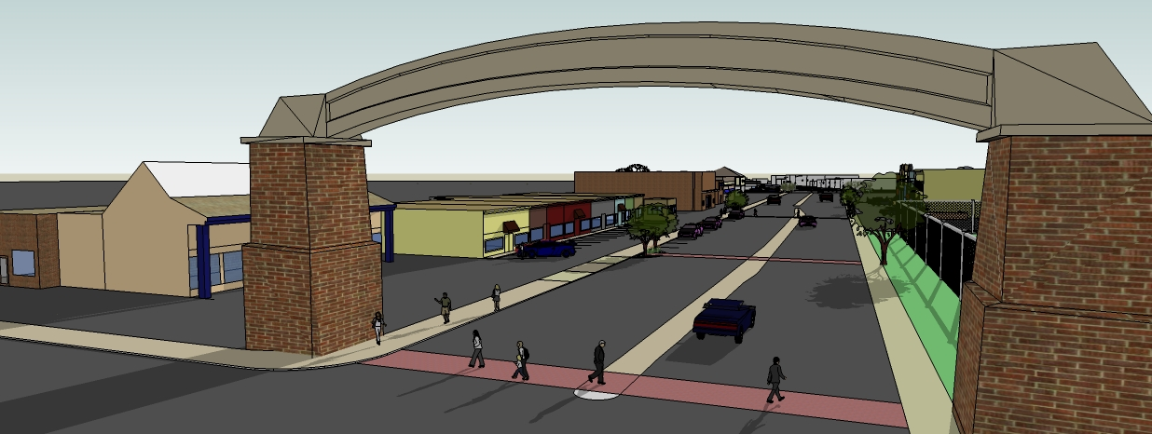
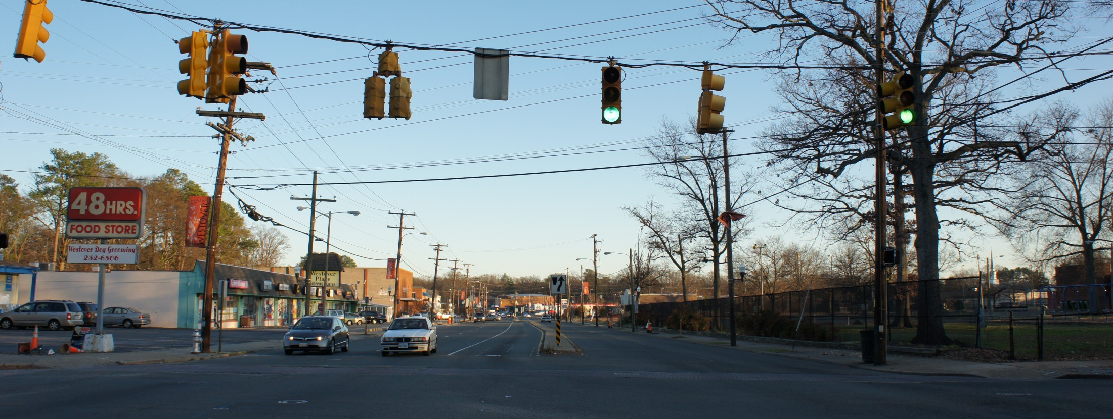
Design Feature At Gateway

Slide 32
Improve the Curb Appeal of the Commercial District
Upgrade Building Facades
Investigate Options for Putting Vacant Lots on Forest Hill Ave. to Productive Use

Slide 33
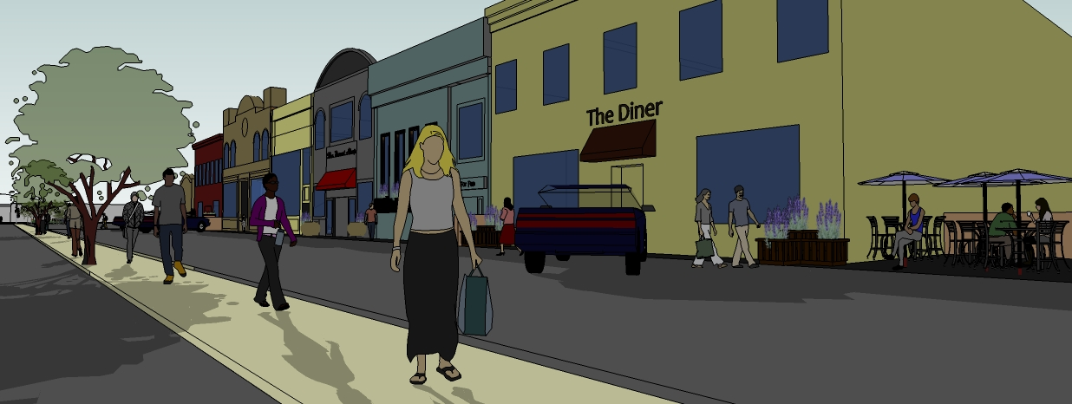
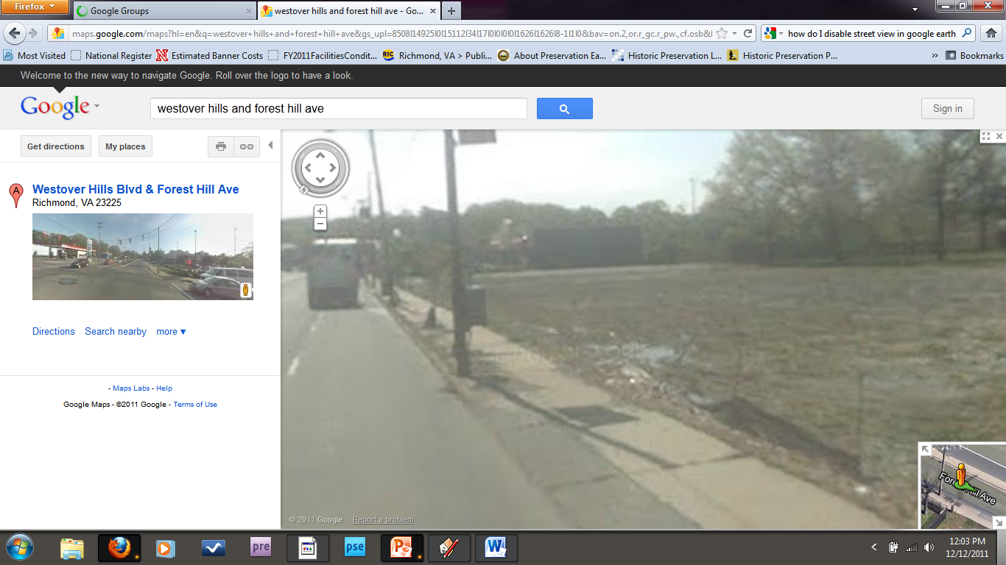
First Design Alternative for the Vacant Lot

Slide 34
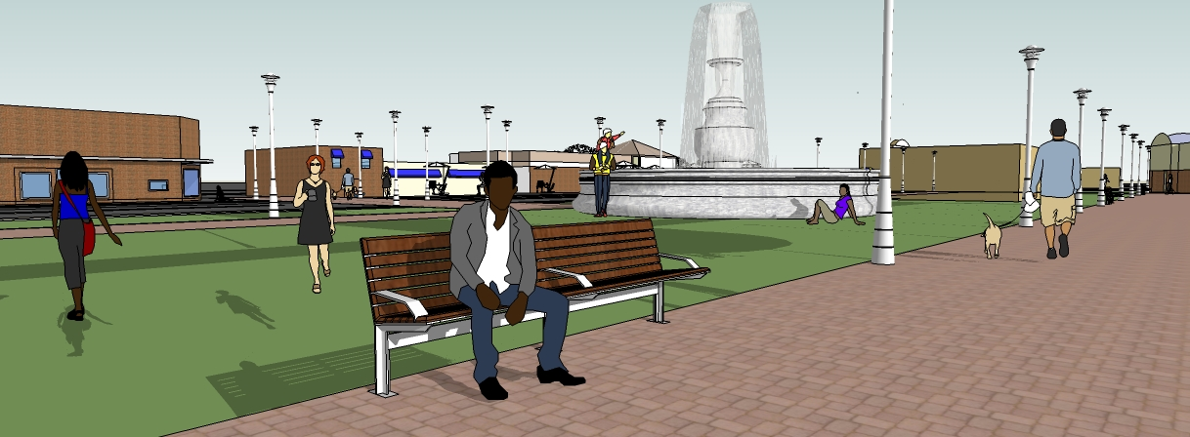
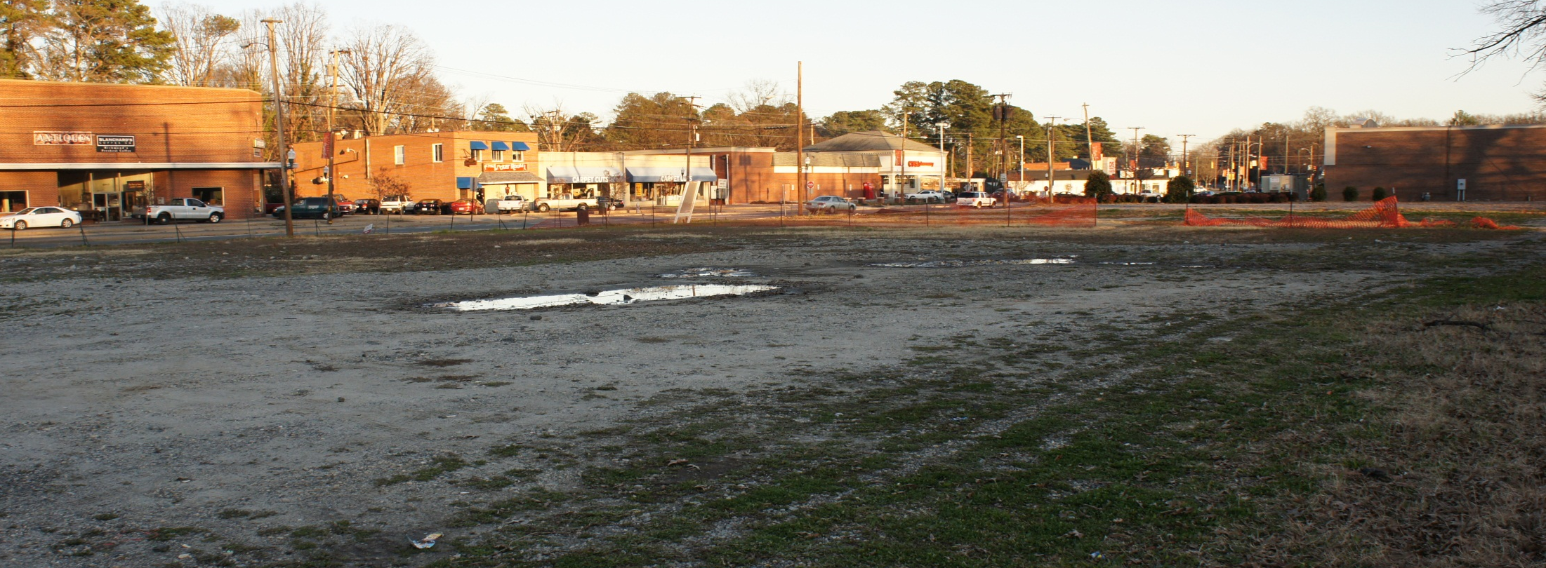
Second Design Alternative for the Vacant Lot

Slide 35
Make the Intersection of Westover Hills and Forest Hill the Visual Focal Point of the District
Make the Intersection the Focal Point
Make the Intersection Safe for all Users
Increase Safety for Pedestrians Crossing the Street

Slide 36
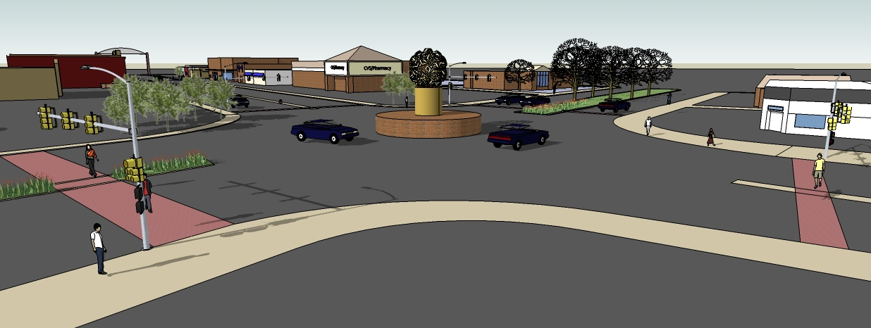
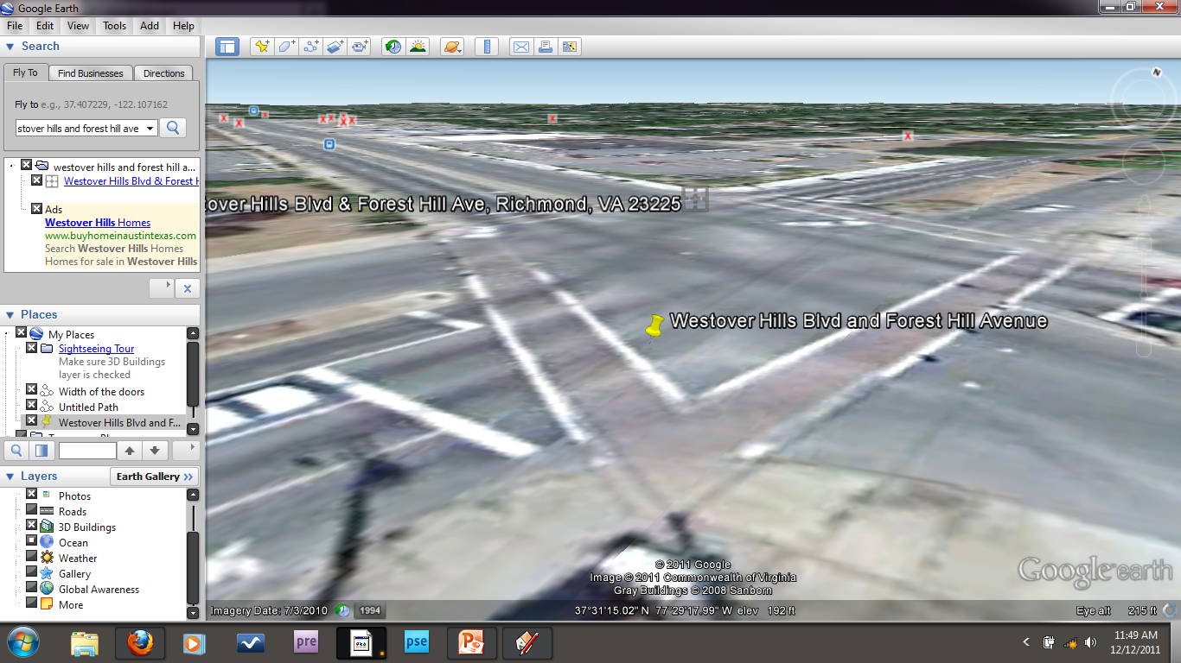
Traffic Circle

Slide 37
Make the Commercial District Pedestrian Friendly
Increase Safety for Pedestrians Crossing the Street
Repair Broken Sidewalks in the District
Expand and Improve Landscaping Features
Notes:
Pedestrian safety
Improve walkability in the district
Trees (create aesthetically pleasing environment)
Median extension, with pedestrian refugee

Slide 38
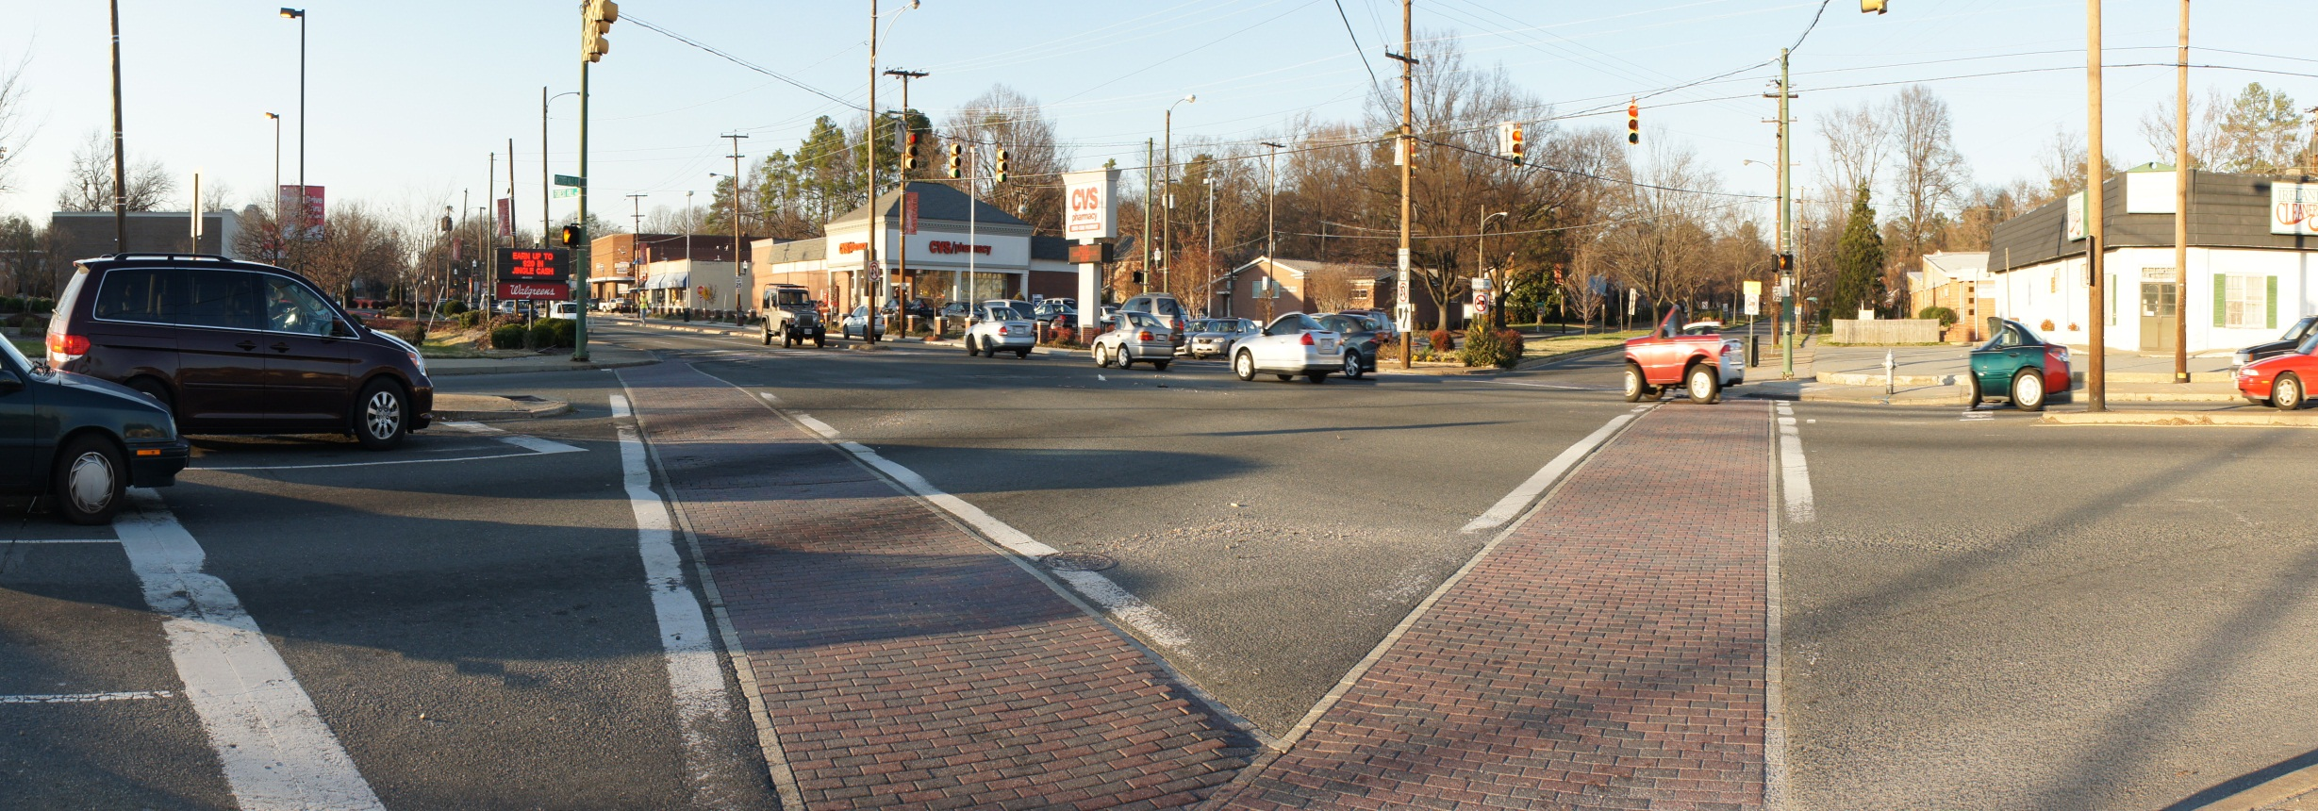
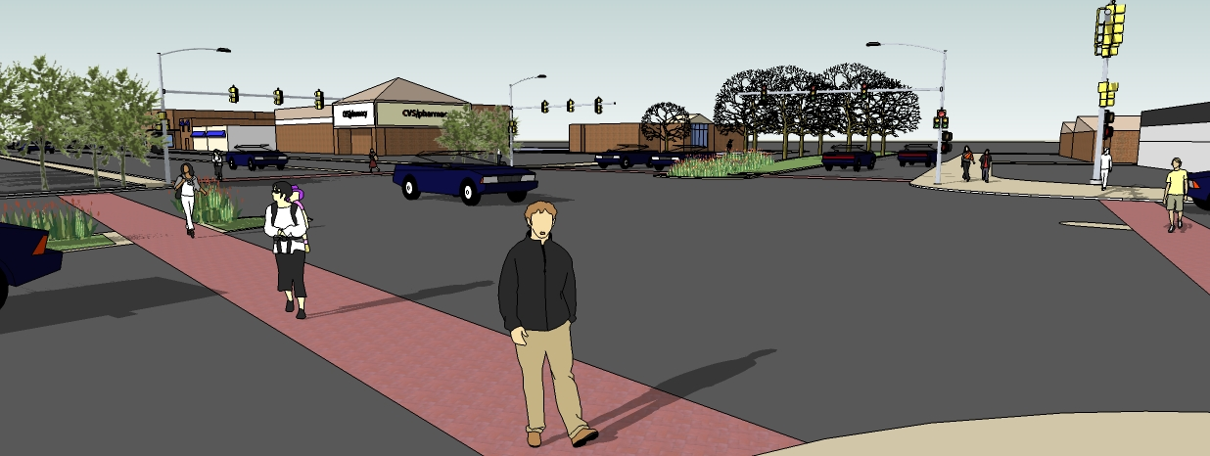
Median Extension with Pedestrian Refuges

Slide 39
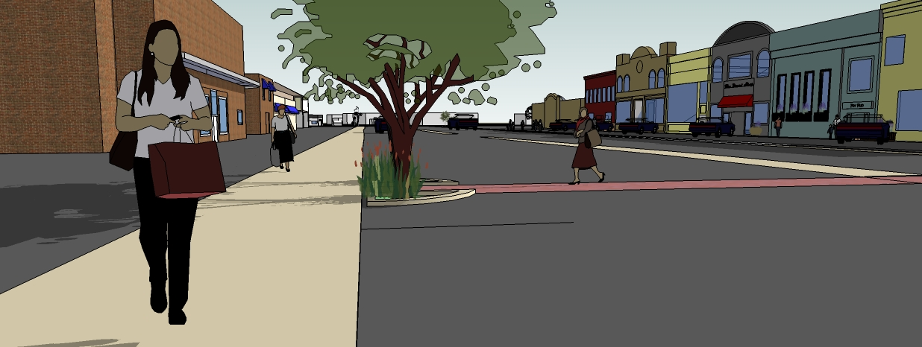
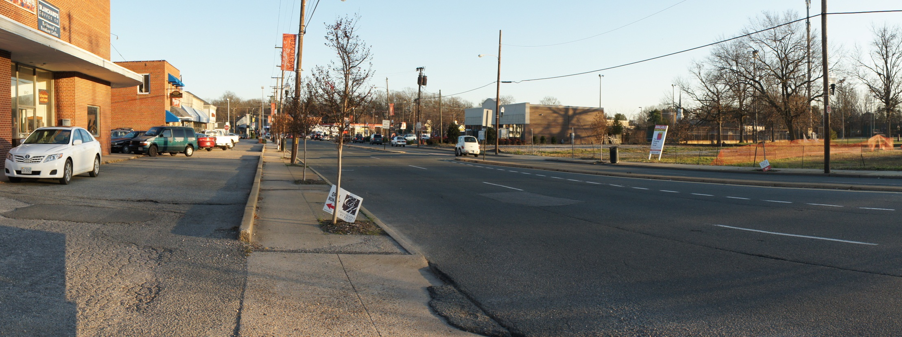
New Crosswalk in Front of Vacant Lot With Trees

Slide 40
Create a Bicycle-Friendly Environment
Incorporate Bicycle Usage
Install Bicycle Parking Racks
Notes:
Improve on-street parking
Image of on-street line and buldbouts

Slide 41
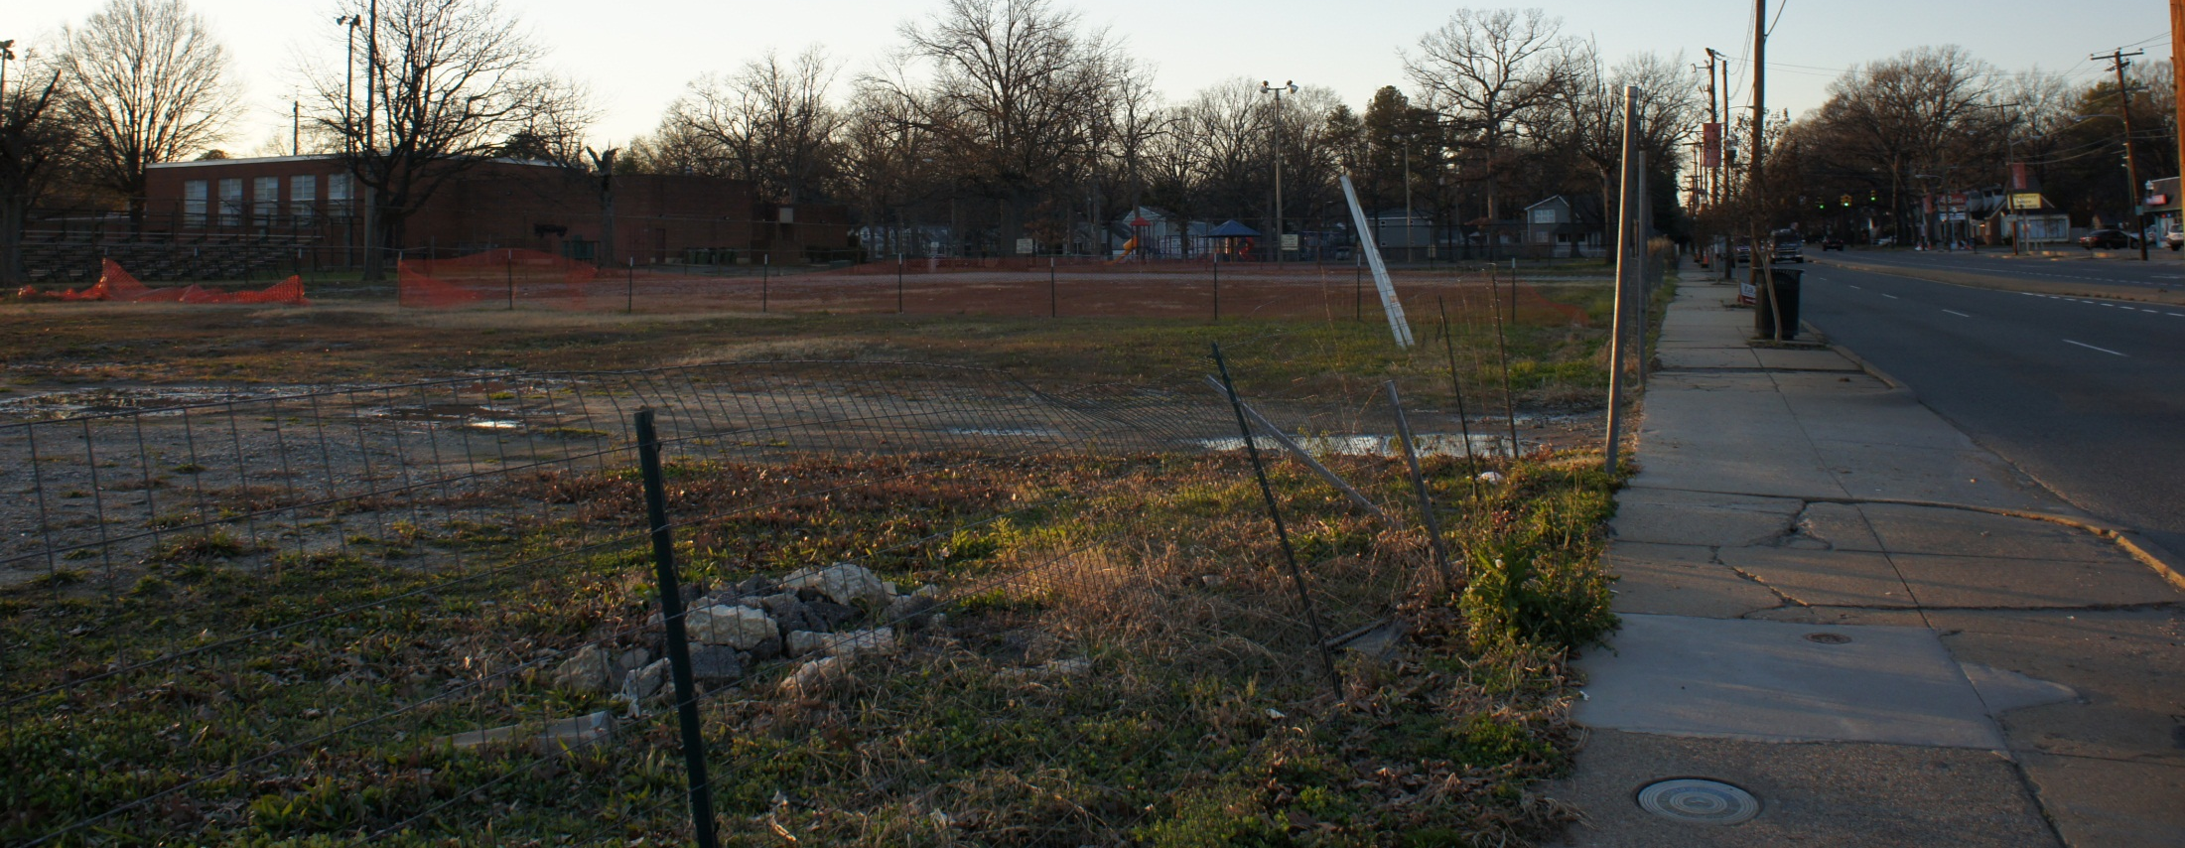
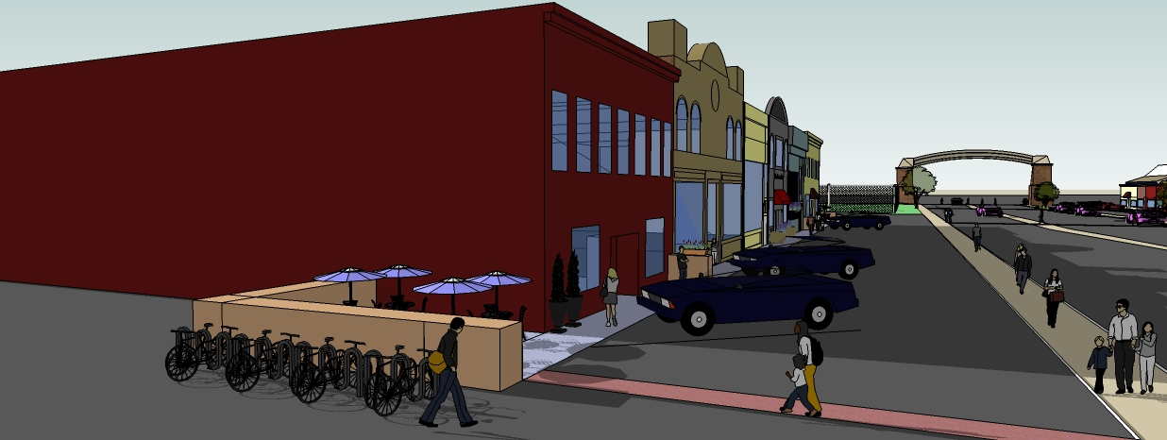
Create A Bicycle-Friendly Environment

Slide 42
Improve Parking Accessibility
Improve On-Street Parking
Improve Off-Street Parking
Notes:
Incorporate bicycle usage in the district
Pics of sharrows and bike parking

Slide 43
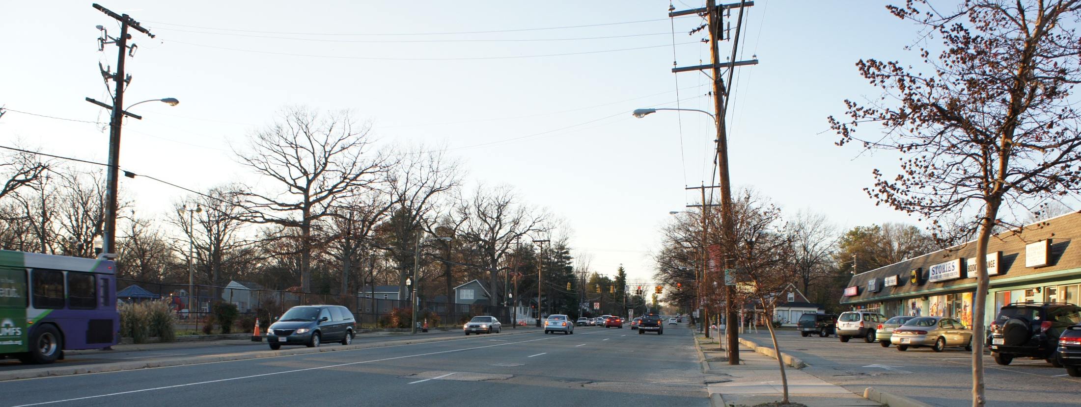
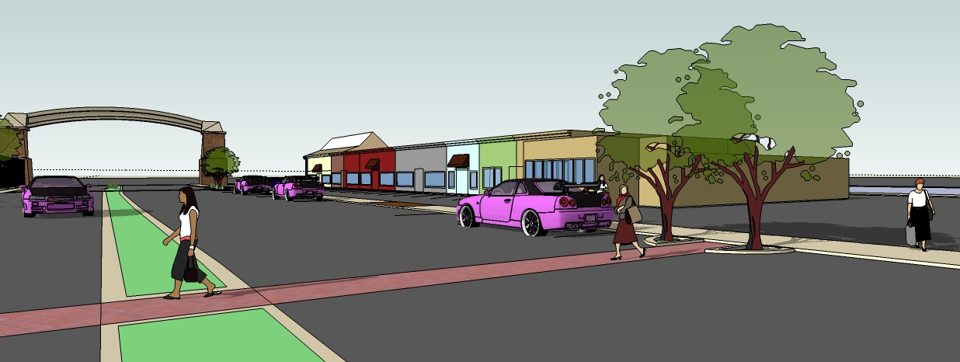
Improved On-Street Parking

Slide 44
Conclusion
Website For Report & Links
Appendices
Implementation Timetable
Implementation Handbook
http://www.has.vcu.edu/usp/MURP/urbcomm

Slide 45
Thank You! Discussion
http://www.has.vcu.edu/usp/MURP/urbcomm

